Slide 1
The Fundamentals of Reinforcement Learning
By Joel Keyser

Slide 2
Outline
Introduction: Definition and Scope
Modeling a Situation: Markov Decision Process
Taking Action: Value Functions, Policies
Learning
Agent Goals
Target Calculation
Updating
Design Considerations: Qualities, Frameworks

Slide 3
What is Reinforcement Learning?
Technique used to achieve Artificial Intelligence by giving a machine human-like learning capabilities
Scope
Artificial Intelligence
Machine Learning
Reinforcement Learning
Scope of Reinforcement Learning

Slide 4
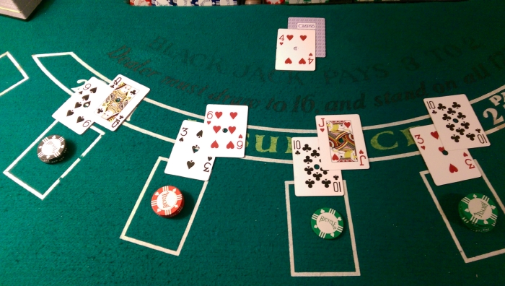
Examples of Reinforcement Learning
Conceptual
Walking robot
Blackjack
Successful
TD Gammon by Gerald Tesauro [1]
AlphaGo by DeepMind [3]
Game of Blackjack [4]

Slide 5
Outline
Introduction: Definition and Scope
Modeling a Situation: Markov Decision Process
Taking Action: Value Functions, Policies
Learning
Agent Goals
Target Calculation
Updating
Design Considerations: Qualities, Frameworks

Slide 6
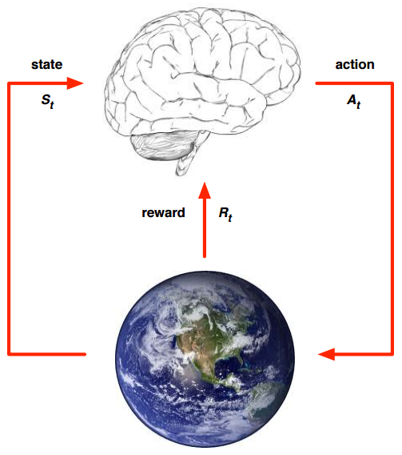
Modeling a Situation: Terminology
Terminology
Agent
Environment
State
Action
Reward
Depiction showing basic interaction between agent and environment [5]

Slide 7
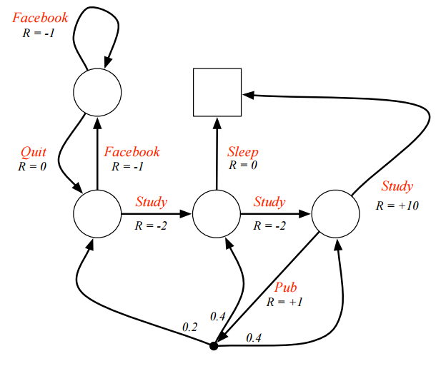
Modeling a Situation: Markov Decision Process (MDP)
MDP
State space
Action space
State transition rules
Reward rules
Episode
Diagram of an MDP for Taking Classes [6]

Slide 8
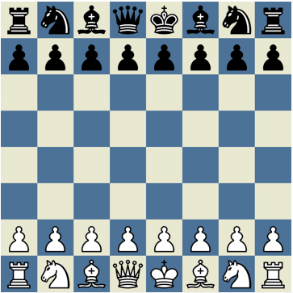
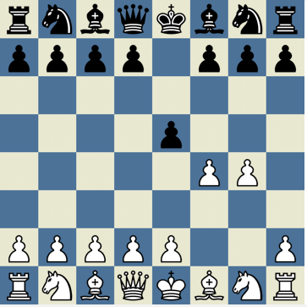
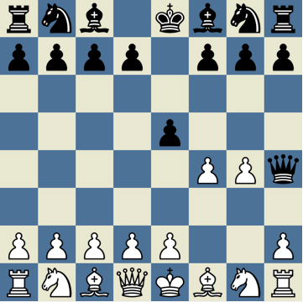
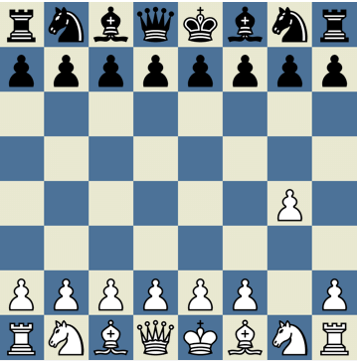
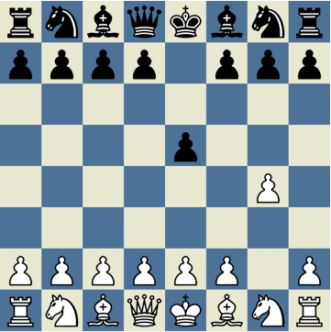
An Episode of an MDP for Chess
s0
s2
r2 = -1
a1 = g4
a2 = f4
r1 = 0
s1
Shows the states, actions, and rewards of the episode. The episode, mathematically, would look like { s0, a1, r1, s1, a2, r2, s2 }.

Slide 9
Outline
Introduction: Definition and Scope
Modeling a Situation: Markov Decision Process
Taking Action: Value Functions, Policies
Learning
Agent Goals
Target Calculation
Updating
Design Considerations: Qualities, Frameworks

Slide 10
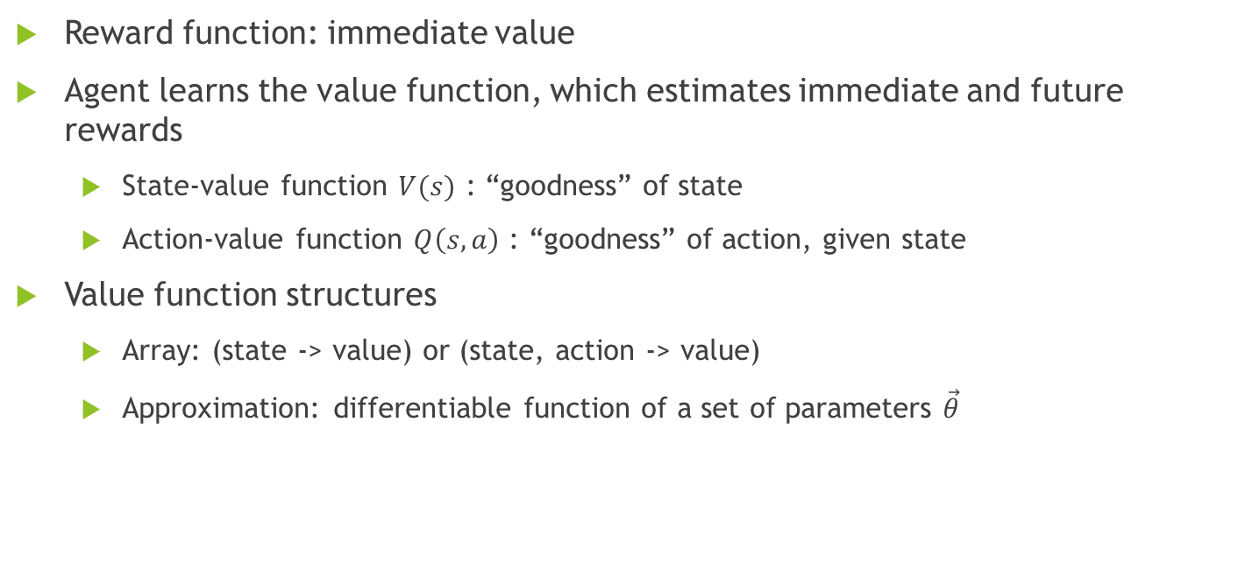
Taking Action: Value Functions
Reward function: immediate value
Agent learns the value function, which estimates immediate and future rewards
State-value function $V(s)$ : “goodness” of state
Action-value function $Q\left(s,a\right)$ : “goodness” of action, given state
Value function structures
Array: (state -> value) or (state, action -> value)
Approximation: differentiable function of a set of parameters $\vec{θ}$

Slide 11
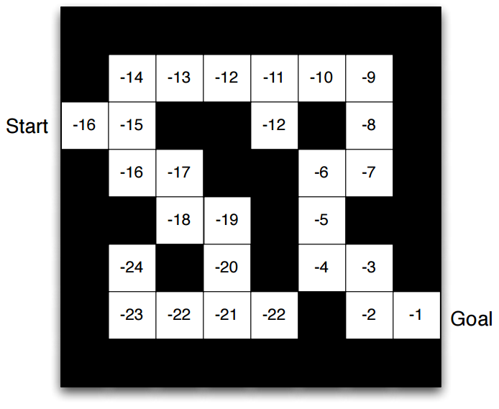
Visual Representation of a True State-Value Function [5]
An action-value function here would have the values between the squares instead of inside them.

Slide 12
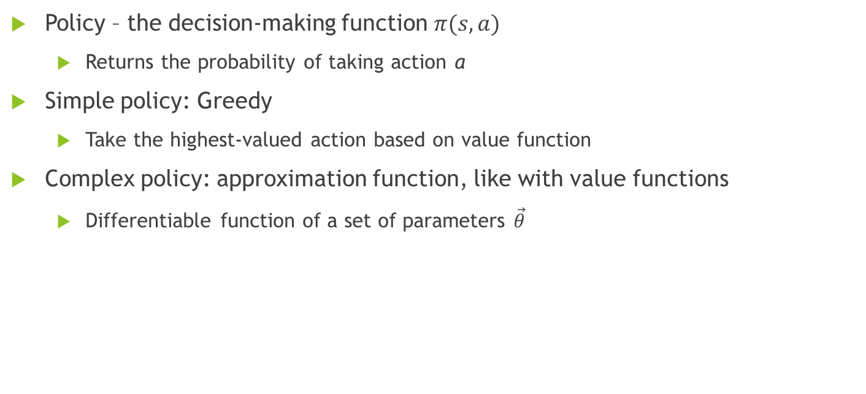
Taking Action: Policies
Policy – the decision-making function $π(s, a)$
Returns the probability of taking action a
Simple policy: Greedy
Take the highest-valued action based on value function
Complex policy: approximation function, like with value functions
Differentiable function of a set of parameters $\vec{θ}$

Slide 13
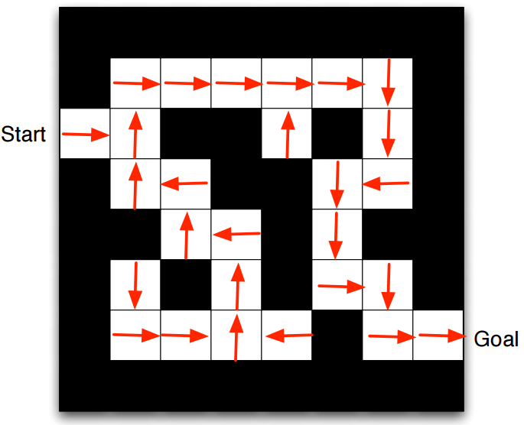
Visual Representation of an Optimal Policy [5]
Shows the best action to take given each possible state.

Slide 14
Outline
Introduction: Definition and Scope
Modeling a Situation: Markov Decision Process
Taking Action: Value Functions, Policies
Learning
Agent Goals
Target Calculation
Updating
Design Considerations: Qualities, Frameworks

Slide 15
Learning: Agent Goals
Learn true value function (value-based)
Learn optimal policy (policy-based)
Learn both true value function and optimal policy simultaneously (actor-critic)

Slide 16
Value-Based Learning
Use a Greedy policy to choose actions
Observe the results of chosen actions
Update the value function towards observed results
Meaning change the value function so that, in the future, its estimate will be closer to the results that were seen

Slide 17
Policy-Based Learning
Step through an entire episode
Observe each individual reward
Update policy towards the rewards
Meaning change the policy so that the actions taken would be more likely to happen again if the reward was good, or less likely if the reward was bad

Slide 18
Actor-Critic Learning
Choose actions using policy
Observe results of those actions
Update the policy towards the value of those results, as determined by the value function
Update the value function towards the results

Slide 19
Outline
Introduction: Definition and Scope
Modeling a Situation: Markov Decision Process
Taking Action: Value Functions, Policies
Learning
Agent Goals
Target Calculation
Updating
Design Considerations: Qualities, Frameworks

Slide 20
Learning: Target Calculation
“Updating towards a value”
Value towards which we update = target
Target always takes actual experience into account
Target calculation methods
Monte Carlo
Temporal Difference (0) (aka TD(0))
Temporal Difference (λ) (aka TD(λ))

Slide 21
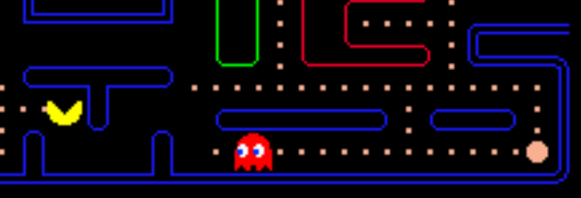
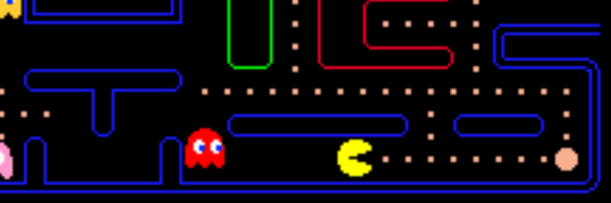
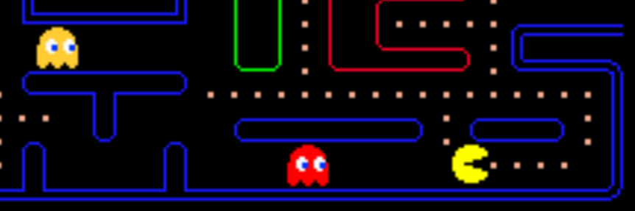
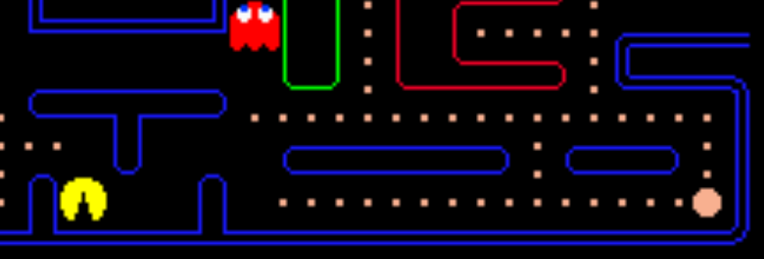
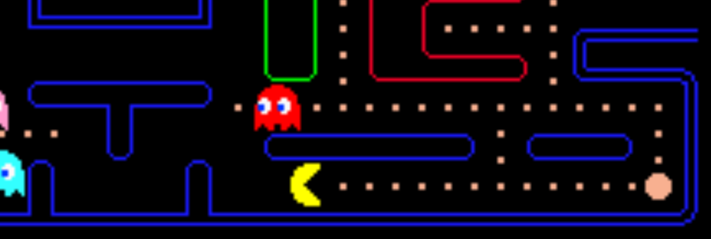
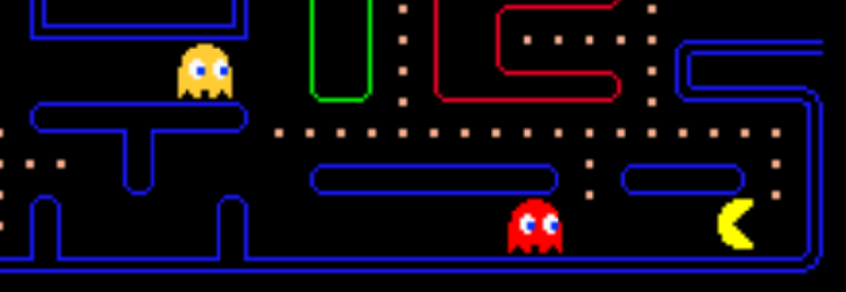
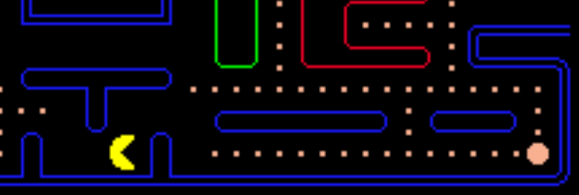
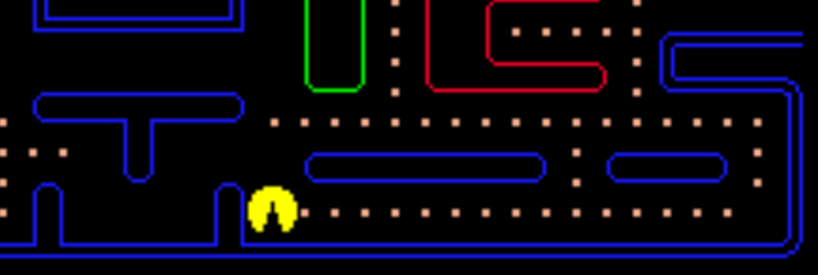
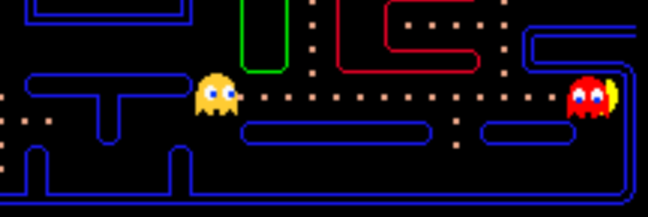
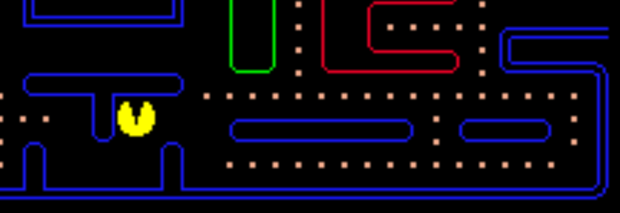
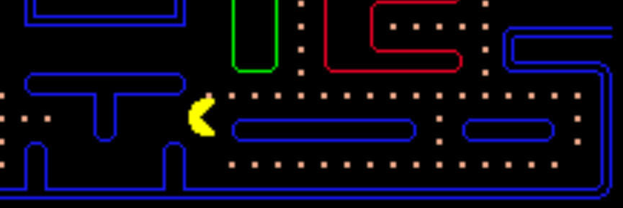
Episode of Pac-Man
a8 = right
r8 = 1
s0
s7
s8
a1 = down
r1 = 0
a7 = right
r7 = 1
a9 = right
r9 = 1
s1
s6
s9
States
Actions
Rewards
1 point for eating
5 steps with r = 0
5 steps with r = 1
a2 = right
r2 = 0
a6 = right
r6 = 1
a10 = up
r10 = 1
s2
s5
s10
a3 = up
r3 = 0
a5 = down
r5 = 0
s3
s4
a4 = right
r4 = 0

Slide 22
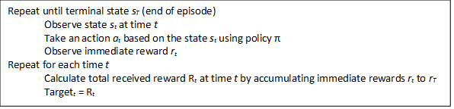
Target Calculation: Monte Carlo Method
Idea: most accurate target is entirely from experience, with no estimation
Basic Monte Carlo algorithm for calculating targets [7]

Slide 23
Episode of Pac-Man
a8 = right
r8 = 1
s0
s7
s8
a1 = down
r1 = 0
a7 = right
r7 = 1
a9 = right
r9 = 1
s1
s6
s9
States
Actions
Rewards
1 point for eating
5 steps with r = 0
5 steps with r = 1
Monte Carlo
Create episode
Sum rewards
a2 = right
r2 = 0
a6 = right
r6 = 1
a10 = up
r10 = 1
s2
s5
s10
a3 = up
r3 = 0
a5 = down
r5 = 0
s3
s4
a4 = right
r4 = 0

Slide 24
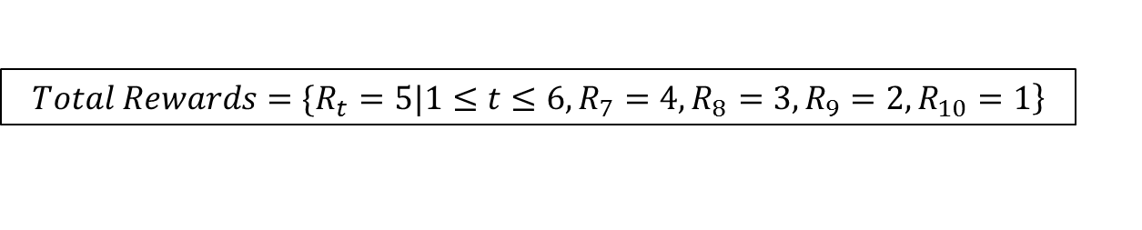
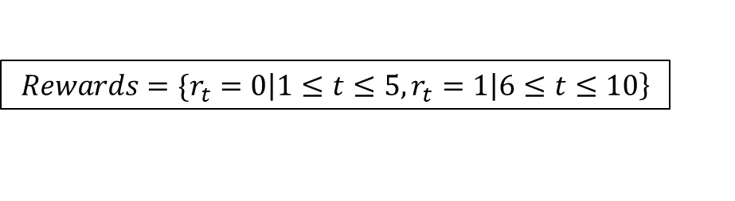
Calculated Values with Monte Carlo
$$\left.Rewards=\{r_{t}=0\left|1≤t≤5,r_{t}=1\right|6≤t≤10\right\}$$
Immediate rewards for Pac-Man episode, calculated in first loop of algorithm.
$$\left.Total Rewards=\{R_{t}=5|1≤t≤6,R_{7}=4,R_{8}=3,R_{9}=2,R_{10}=1\right\}$$
Targets at each time step for Pac-Man episode, calculated in second loop of algorithm.

Slide 25
Monte Carlo Pros/Cons
Pros
Perfect accuracy
Cons
Infrequent target calculation
Once per episode
No accounting for intermediate steps
Checkers ex: getting triple-jumped, but winning

Slide 26
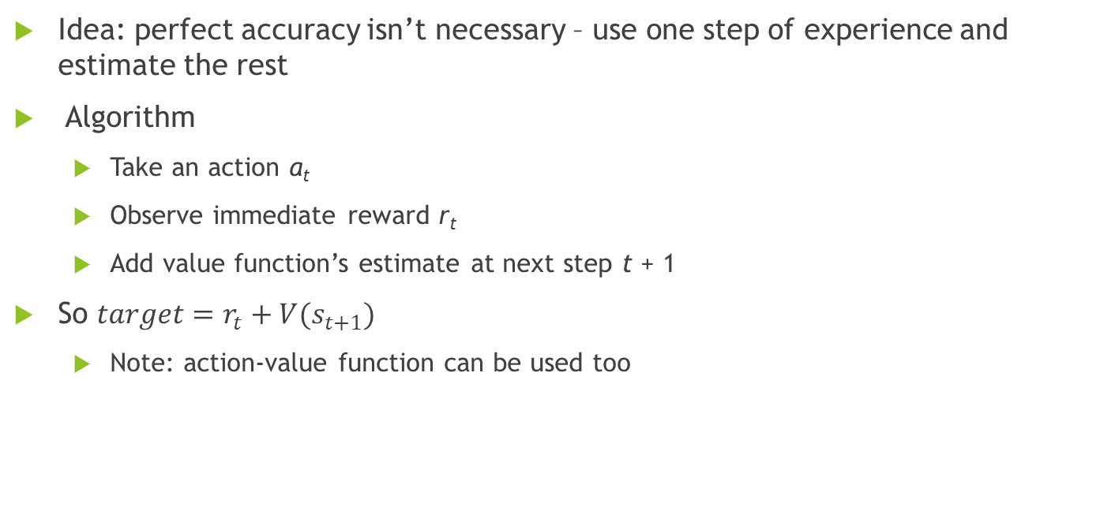
Target Calculation: TD(0) Method
Idea: perfect accuracy isn’t necessary – use one step of experience and estimate the rest
Algorithm
Take an action a_{t}
Observe immediate reward r_{t}
Add value function’s estimate at next step t + 1
So $target=r_{t}+V(s_{t+1})$
Note: action-value function can be used too

Slide 27
Episode of Pac-Man
a8 = right
r8 = 1
s0
s7
s8
a1 = down
r1 = 0
a7 = right
r7 = 1
a9 = right
r9 = 1
s1
s6
s9
States
Actions
Rewards
1 point for eating
5 steps with r = 0
5 steps with r = 1
TD(0)
Step
Check reward
Estimate future
a2 = right
r2 = 0
a6 = right
r6 = 1
a10 = up
r10 = 1
s2
s5
s10
a3 = up
r3 = 0
a5 = down
r5 = 0
s3
s4
a4 = right
r4 = 0

Slide 28

Calculated Values with TD(0)
Assuming existing value function $V\left(s_{t}\right)=\left\{\begin{aligned}&5|1≤t≤7 \\ &3|8≤t≤9 \\ &1|t=10\end{aligned}\right.$
${target}_{t}=r_{t}+V(s_{t+1})$
${target}_{8}=r_{8}+V(s_{8+1})$ = 1 + 3 = 4
Slightly off of Monte Carlo’s, which was ${target}_{8}=3$

Slide 29
TD(0) Pros/Cons
Pros
Frequent target calculations
Once per step
Accounts for intermediate steps
Cons
Less accurate

Slide 30
Target Calculation: TD(λ)
TD(λ) idea: combine the concepts of Monte Carlo and TD(0)
E.g. take three steps, observe three rewards, estimate the rest
Each step/estimate possibility has its own combination of benefits of accuracy and efficiency
TD(λ) attempts to use the most advantageous combination
Forward TD(λ) vs Backward TD(λ)

Slide 31
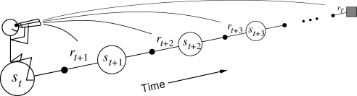
Forward TD(λ)
Algorithm
Calculate target for each step/estimate combination
Weigh each target by λ
Typically more weight on TD(0)-like targets
Desired target = sum(weighted sub-targets)
Visualization of Forward TD(λ) [7]

Slide 32
Forward TD(λ) Pros/Cons
Pros
Accounts for intermediate steps
Somewhat high accuracy
Cons
Infrequent target calculations
Slow

Slide 33
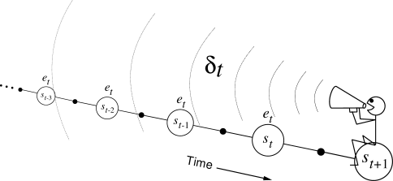
Backwards TD(λ)
Does not calculate a TD(λ) target directly
Uses a TD(0) target, but keeps an eligibility trace
Eligibility trace determines how responsible each state is for the reward
Array with a value for each state
Incremented when a state is seen
Decayed every time step
Visualization of Backwards TD(λ) [7]. 𝛿 is the error between TD(0) target and current value function estimates.

Slide 34
Outline
Introduction: Definition and Scope
Modeling a Situation: Markov Decision Process
Taking Action: Value Functions, Policies
Learning
Agent Goals
Target Calculation
Updating
Design Considerations: Qualities, Frameworks

Slide 35
Learning: Updating
Core of learning
Differences in updating
Updating an array
Updating an approximation function

Slide 36
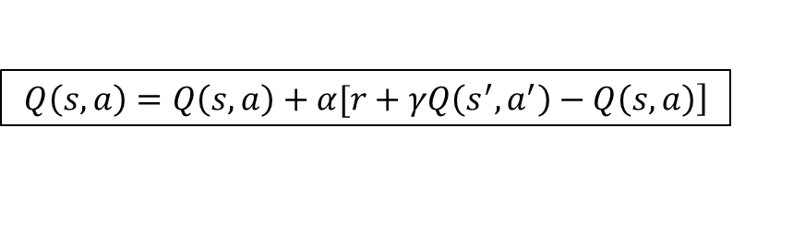
Updating an Array
$$\left.Q\left(s,a\right)=Q\left(s,a\right)+α[r+γQ\left(s^{′},a^{′}\right)−Q\left(s,a\right)\right]$$
Updating an action-value function array [7]
Updates action-value function
Towards TD(0) target
𝛾 discounts the value of future reward
Future reward isn’t “for sure”
α determines how much of the target to consider
Reduces variance

Slide 37
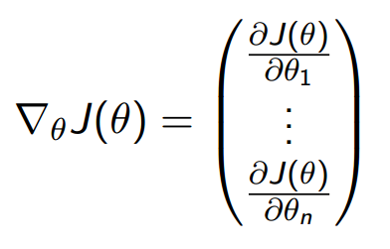



Updating a Function of $\vec{θ}$
Problem: all actions’ values affected on update
Q(s, a, $\vec{θ}$)
Solution: gradient
Vector of partial derivatives
Points in direction of greatest positive slope
Gradient of a function J($\vec{θ}$) [8]

Slide 38
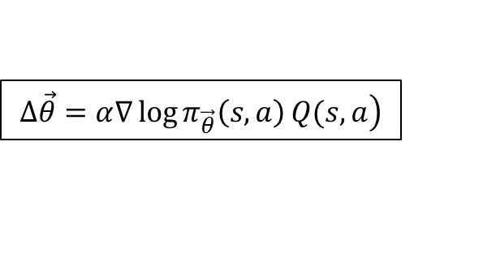
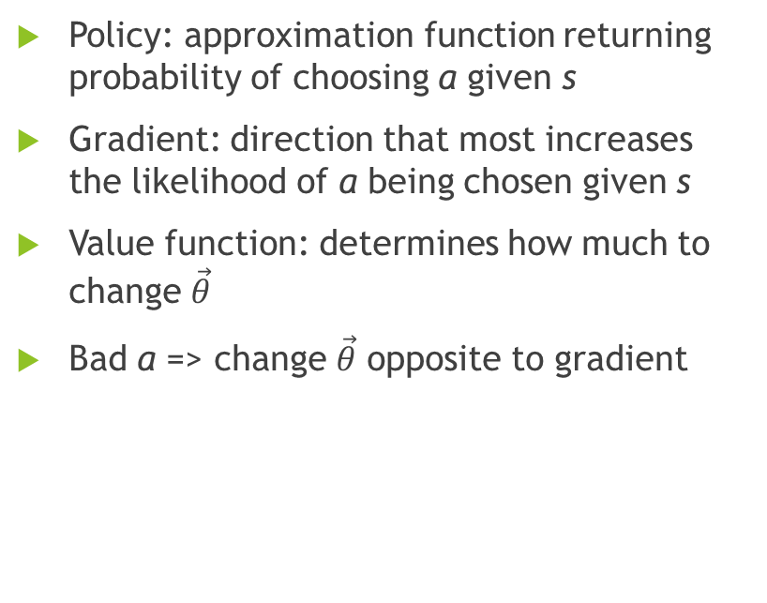
Using Gradient in Updating a Policy
Policy: approximation function returning probability of choosing a given s
Gradient: direction that most increases the likelihood of a being chosen given s
Value function: determines how much to change $\vec{θ}$
Bad a => change $\vec{θ}$ opposite to gradient
$$\left.∆\vec{θ}=α∇\log{π_{\vec{θ}}\left(s,a\right)}Q(s,a\right)$$
Assignment using gradient [8]

Slide 39
Outline
Introduction: Definition and Scope
Modeling a Situation: Markov Decision Process
Taking Action: Value Functions, Policies
Learning
Agent Goals
Target Calculation
Updating
Design Considerations: Qualities, Frameworks

Slide 40
Design Considerations
Considerations
Software qualities
Frameworks
Reasons
Complicated software
Research and Development currently has a major role

Slide 41
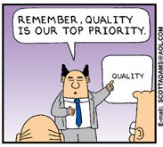
Valued Software Qualities
Modifiability
Frequent changes
Reusability
Share findings
Extensibility
Add to findings
High performance
Quicker training
Dilbert comic [2]

Slide 42

Frameworks
Hand-in-hand with reusability
Framework – can provide operations, but specifically provides design
Library provides operations
Allows people with limited time & knowledge to develop
Import the framework and fill it out
House skeleton [9]

Slide 43
Conclusion
Reinforcement learning is an effective technique for creating Artificial Intelligence
Grasping the fundamentals is important if you want to use it properly
Remember the qualities if you want to contribute to the field

Slide 44
References
[1] Tesauro, G. (1995). Temporal difference learning and TD-Gammon. Commun. ACM, 58-68.
[2] Black, D. B. (2012, April 12). Why Software Quality Stinks. Retrieved March 03, 2017, from http://www.blackliszt.com/software-quality/
[3] Silver D, Huang A, Maddison CJ, Guez A, Sifre L, van den Driessche G, Schrittwieser J, Antonoglou I, Panneershelvam V, Lanctot M, Dieleman S, Grewe D, Nham J, Kalchbrenner N, Sutskever I, Lillicrap T, Leach M, Kavukcuoglu K, Graepel T, Hassabis D (2016) Mastering the game of go with deep neural networks and tree search. Nature 529(7587):484–489
[4] How to Play Blackjack. (n.d.). Retrieved March 03, 2017, from https://www.blackjackapprenticeship.com/resources/how-to-play-blackjack/

Slide 45
References
[5] Silver, D. (2015). Lecture 1: Introduction to Reinforcement Learning [Lecture notes]. Retrieved from http://www0.cs.ucl.ac.uk/staff/d.silver/web/Teaching_files/intro_RL.pdf
[6] Silver, D. (2015). Lecture 2: Markov Decision Processes [Lecture notes]. Retrieved from http://www0.cs.ucl.ac.uk/staff/d.silver/web/Teaching_files/MDP.pdf
[7] Sutton, R. S., & Barto, A. G. (1998). Reinforcement Learning: An Introduction (1st ed.). Cambridge, MA: MIT Press.
[8] Silver, D. (2015). Lecture 7: Policy Gradient [Lecture notes]. Retrieved from http://www0.cs.ucl.ac.uk/staff/d.silver/web/Teaching_files/pg.pdf
[9] B. (2016, August 10). Do you want a framework or a solution? Retrieved March 03, 2017, from http://www.ontestautomation.com/do-you-want-a-framework-or-a-solution/

Slide 46

Questions?
Introduction: Definition and Scope
Modeling a Situation: Markov Decision Process
Taking Action: Value Functions, Policies
Learning
Agent Goals
Target Calculation
Updating
Design Considerations: Qualities, Frameworks

